Slide 1


DESIGN 1
Lesson 3: Independent Build - Expanding Your Homepage
Ms. Abboud · Grade 9 - Design 1 · Term 1, Week 2

Slide 2
Learning Objectives
WALT - We Are Learning To
WILF - What I'm Looking For
Apply correct HTML document structure to expand your personal website homepage.
Work independently to add multiple headings and paragraphs, nested correctly.
File structure is valid and complete.
Content is organized logically under clear headings.

Slide 3
Frayer Model: Nesting (Review)
DEFINITION
CHARACTERISTICS
Placing one HTML element inside another, so the inner element is fully contained within the outer one.
One element fully inside another; inner tags close before outer tags.
NESTING (REVIEW)
EXAMPLES
NON-EXAMPLES
<li> inside <ul>; <strong> inside <p>.
Two tags placed side-by-side, not inside one another.

Slide 4
National Identity Integration
UAE Digital Economy: every clearly structured webpage you build is a small-scale example of the digital infrastructure the UAE is investing in as it grows a knowledge-based economy. The same logical organization you practice today, breaking a page into head and body, nesting elements correctly, is exactly what powers the government services, banking apps, and businesses that make up the UAE's digital economy.

Slide 5
STARTER
Quick share
What's one part of your website from last week that felt confusing to build?
Hook · Engage & Ask
5 - 10 minutes

Slide 6
LESSON CORE
I Do: Today's Challenge
Quick review: the structure checklist from Lesson 2.
Today's challenge: expand last week's index.html into a richer homepage with multiple headings and paragraphs.
Gradual Release of Responsibility
Example: an expanded, properly nested homepage
30 - 40 minutes
<!DOCTYPE html>
<html>
<head>
<title>About Me</title>
</head>
<body>
<h1>Hi, I'm [Your Name]</h1>
<p>A short introduction paragraph.</p>
<h2>My Interests</h2>
<p>A paragraph about hobbies or interests.</p>
</body>
</html>
1 / 2

Slide 7
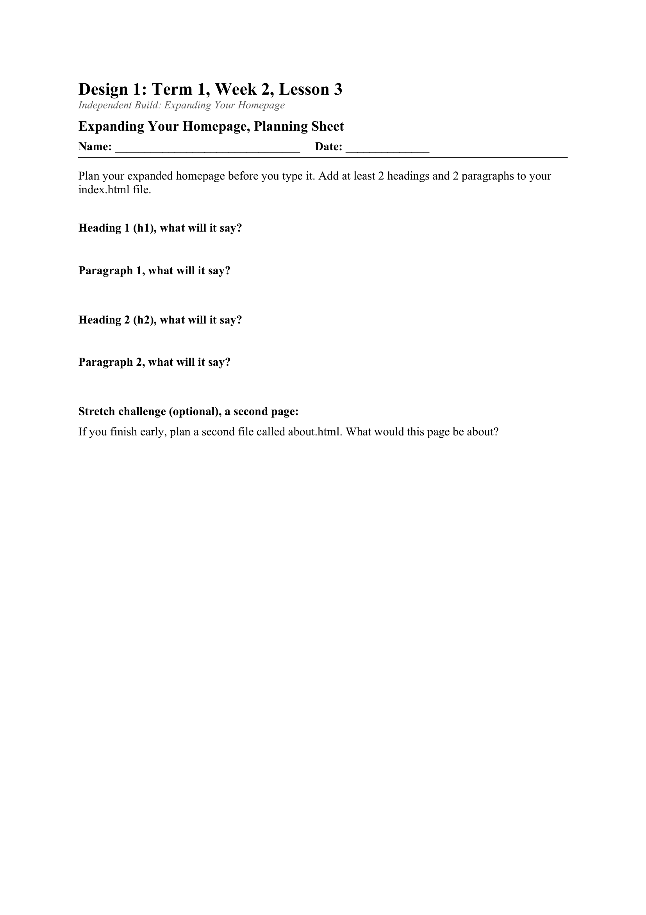
LESSON CORE
You Do: Plan & Build
Work independently or in pairs to restructure and expand your file.
Early finishers: start a second file, about.html, to think ahead to multi-page sites.
Activity: Expanding Your Homepage, Planning Sheet
Gradual Release of Responsibility
30 - 40 minutes
2 / 2

Slide 8
CLOSURE
Informal check
No formal exit ticket today. The teacher circulates and checks in with each student or pair as they wrap up.
Transition & Extend
5 - 10 minutes

